Slide 1

The hot hand fallacy
Notes on Behavioural Economics
Jason Collins

Slide 2


Slide 3


Slide 4
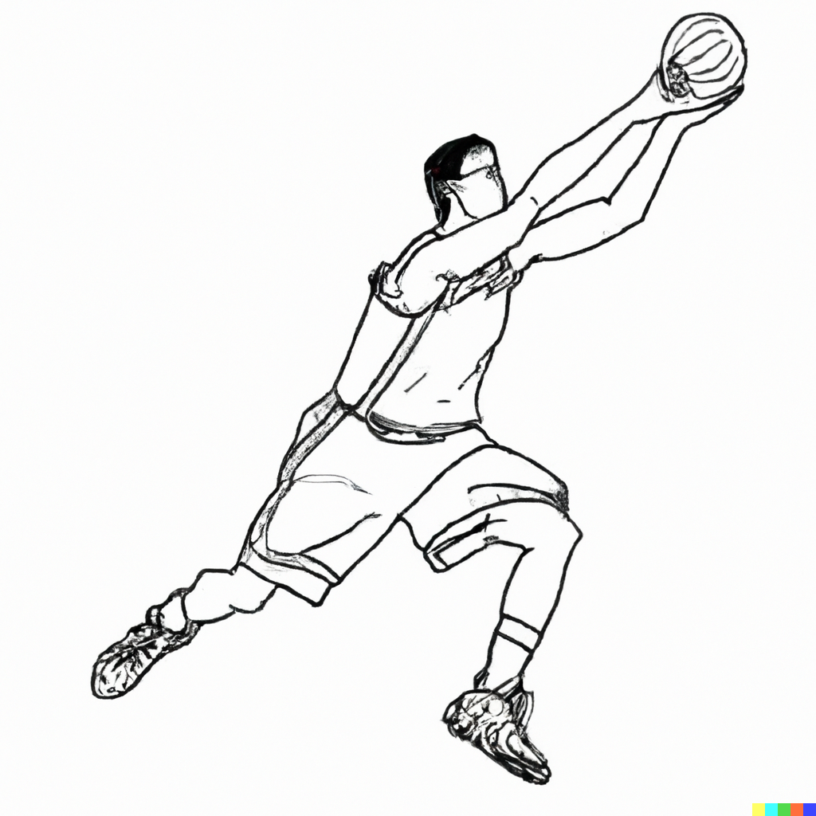

Slide 5
Sequence
H H H
H H T
H T H
H T T
T H H
T H T
T T H
T T T

Slide 6
Sequence | Proportion heads after heads
H H H | 100%
H H T | 50%
H T H | 0%
H T T | 0%
T H H | 100%
T H T | 0%
T T H | -
T T T | -

Slide 7
Sequence | Proportion heads after heads
H H H | 100%
H H T | 50%
H T H | 0%
H T T | 0%
T H H | 100%
T H T | 0%
T T H | -
T T T | -
Expected value | 41.7%

Slide 8
A
B
C

Slide 9
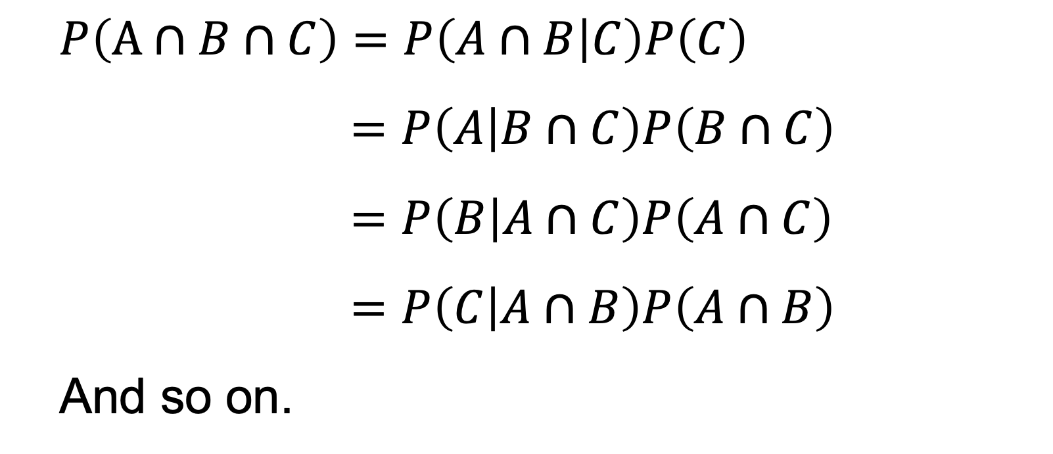
$$P\left(A∩B∩C\right)=P\left(A∩B | C\right)P\left(C\right)$$
$$=P\left(A | B∩C\right)P\left(B∩C\right)$$
$$=P\left(B | A∩C\right)P\left(A∩C\right)$$
$$=P\left(C | A∩B\right)P\left(A∩B\right)$$
And so on.

Slide 10
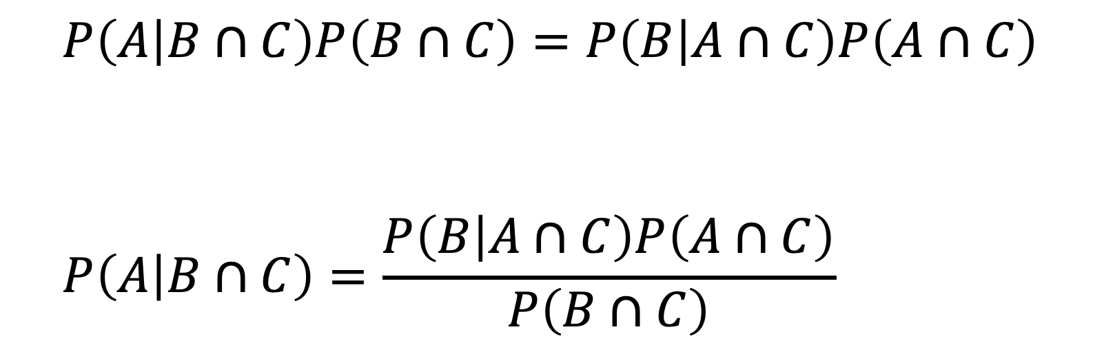
$$P\left(A | B∩C\right)P\left(B∩C\right)=P\left(B | A∩C\right)P\left(A∩C\right)$$
$$P\left(A | B∩C\right)=\frac{P\left(B | A∩C\right)P\left(A∩C\right)}{P\left(B∩C\right)}$$

Slide 11
1
2
3

Slide 12
1
2
3
H

Slide 13
1
2
3
H
H

Slide 14
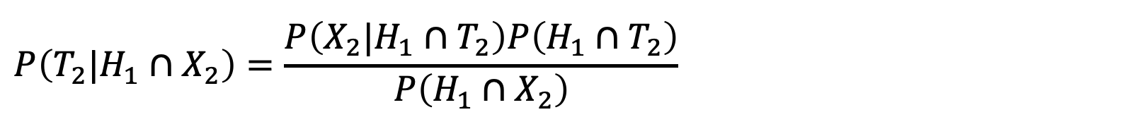
$$P\left(T_{2}|H_{1}∩X_{2}\right)=\frac{P\left(X_{2}|H_{1}∩T_{2}\right)P\left(H_{1}∩T_{2}\right)}{P\left(H_{1}∩X_{2}\right)}$$

Slide 15
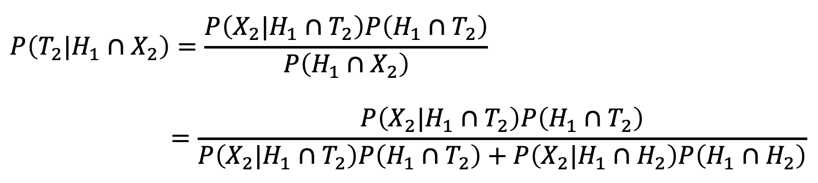
$$P\left(T_{2}|H_{1}∩X_{2}\right)=\frac{P\left(X_{2}|H_{1}∩T_{2}\right)P\left(H_{1}∩T_{2}\right)}{P\left(H_{1}∩X_{2}\right)}$$
$$=\frac{P\left(X_{2}|H_{1}∩T_{2}\right)P\left(H_{1}∩T_{2}\right)}{P\left(X_{2}|{H_{1}∩T}_{2}\right)P\left(H_{1}∩T_{2}\right)+P\left(X_{2}|H_{1}∩H_{2}\right)P\left(H_{1}∩H_{2}\right)}$$

Slide 16
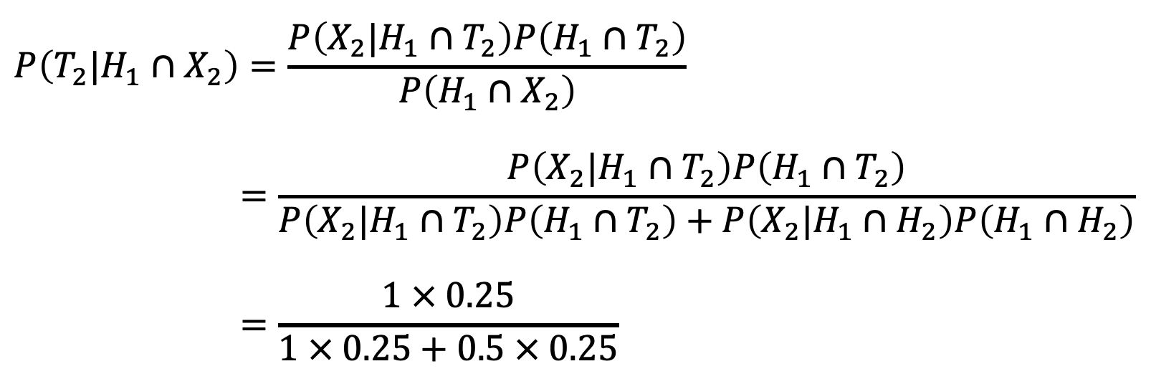
$$P\left(T_{2}|H_{1}∩X_{2}\right)=\frac{P\left(X_{2}|H_{1}∩T_{2}\right)P\left(H_{1}∩T_{2}\right)}{P\left(H_{1}∩X_{2}\right)}$$
$$=\frac{P\left(X_{2}|H_{1}∩T_{2}\right)P\left(H_{1}∩T_{2}\right)}{P\left(X_{2}|{H_{1}∩T}_{2}\right)P\left(H_{1}∩T_{2}\right)+P\left(X_{2}|H_{1}∩H_{2}\right)P\left(H_{1}∩H_{2}\right)}$$
$$=\frac{1 × 0.25}{1 × 0.25+0.5 × 0.25}$$

Slide 17
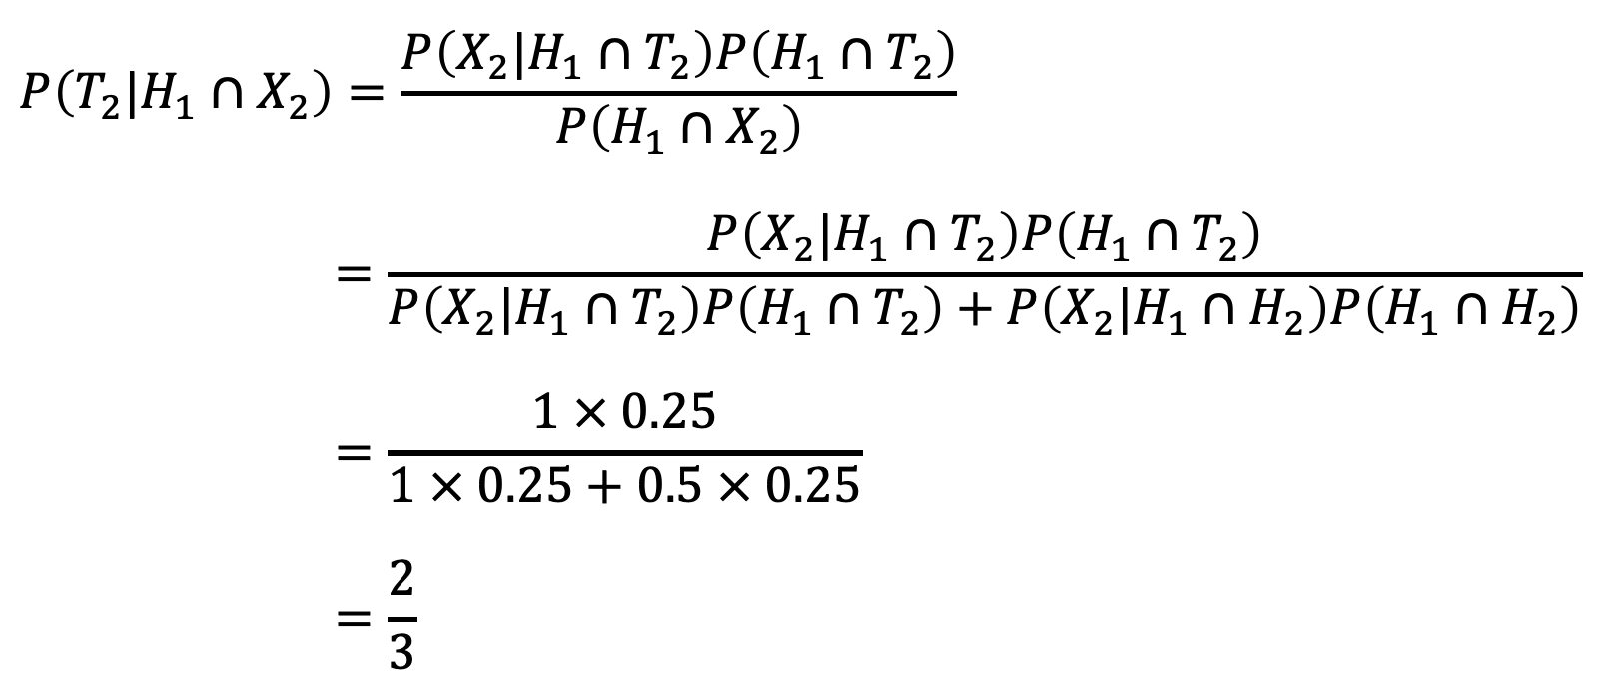
$$P\left(T_{2}|H_{1}∩X_{2}\right)=\frac{P\left(X_{2}|H_{1}∩T_{2}\right)P\left(H_{1}∩T_{2}\right)}{P\left(H_{1}∩X_{2}\right)}$$
$$=\frac{P\left(X_{2}|H_{1}∩T_{2}\right)P\left(H_{1}∩T_{2}\right)}{P\left(X_{2}|{H_{1}∩T}_{2}\right)P\left(H_{1}∩T_{2}\right)+P\left(X_{2}|H_{1}∩H_{2}\right)P\left(H_{1}∩H_{2}\right)}$$
$$=\frac{1 × 0.25}{1 × 0.25+0.5 × 0.25}$$
$$=\frac{2}{3}$$

Slide 18
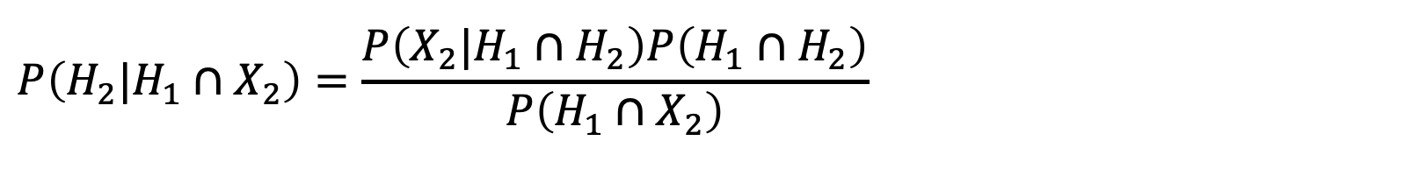
$$P\left(H_{2}|H_{1}∩X_{2}\right)=\frac{P\left(X_{2}|H_{1}∩H_{2}\right)P\left(H_{1}∩H_{2}\right)}{P\left(H_{1}∩X_{2}\right)}$$

Slide 19
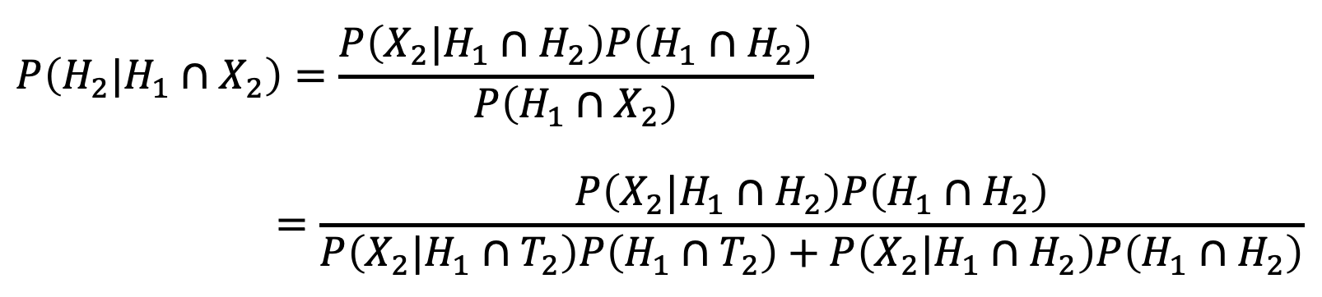
$$P\left(H_{2}|H_{1}∩X_{2}\right)=\frac{P\left(X_{2}|H_{1}∩H_{2}\right)P\left(H_{1}∩H_{2}\right)}{P\left(H_{1}∩X_{2}\right)}$$
$$=\frac{P\left(X_{2}|H_{1}∩H_{2}\right)P\left(H_{1}∩H_{2}\right)}{P\left(X_{2}|{H_{1}∩T}_{2}\right)P\left(H_{1}∩T_{2}\right)+P\left(X_{2}|H_{1}∩H_{2}\right)P\left(H_{1}∩H_{2}\right)}$$

Slide 20
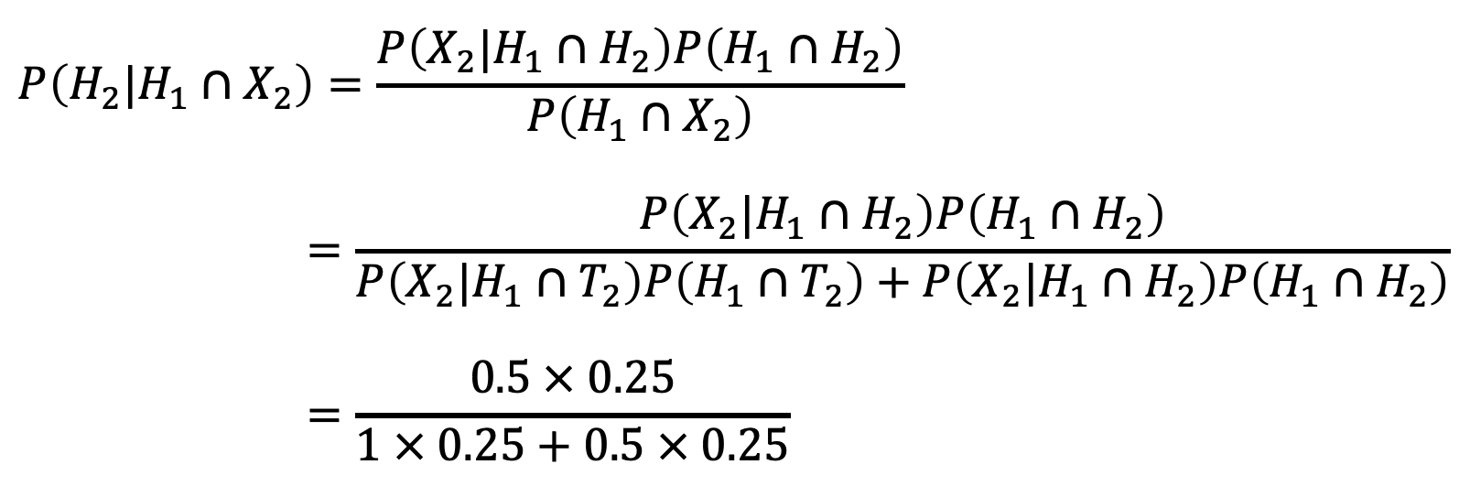
$$P\left(H_{2}|H_{1}∩X_{2}\right)=\frac{P\left(X_{2}|H_{1}∩H_{2}\right)P\left(H_{1}∩H_{2}\right)}{P\left(H_{1}∩X_{2}\right)}$$
$$=\frac{P\left(X_{2}|H_{1}∩H_{2}\right)P\left(H_{1}∩H_{2}\right)}{P\left(X_{2}|{H_{1}∩T}_{2}\right)P\left(H_{1}∩T_{2}\right)+P\left(X_{2}|H_{1}∩H_{2}\right)P\left(H_{1}∩H_{2}\right)}$$
$$=\frac{0.5 × 0.25}{1 × 0.25+0.5 × 0.25}$$

Slide 21
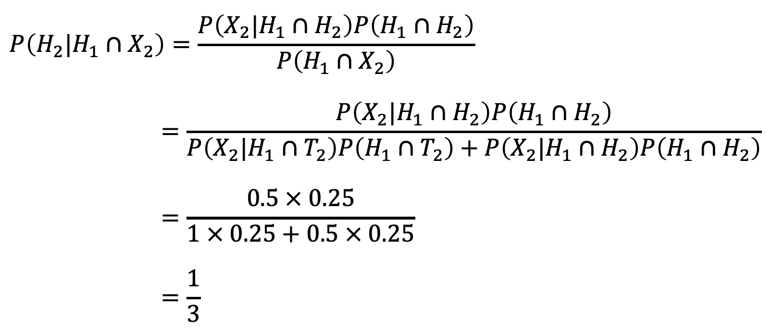
$$P\left(H_{2}|H_{1}∩X_{2}\right)=\frac{P\left(X_{2}|H_{1}∩H_{2}\right)P\left(H_{1}∩H_{2}\right)}{P\left(H_{1}∩X_{2}\right)}$$
$$=\frac{P\left(X_{2}|H_{1}∩H_{2}\right)P\left(H_{1}∩H_{2}\right)}{P\left(X_{2}|{H_{1}∩T}_{2}\right)P\left(H_{1}∩T_{2}\right)+P\left(X_{2}|H_{1}∩H_{2}\right)P\left(H_{1}∩H_{2}\right)}$$
$$=\frac{0.5 × 0.25}{1 × 0.25+0.5 × 0.25}$$
$$=\frac{1}{3}$$

Slide 22
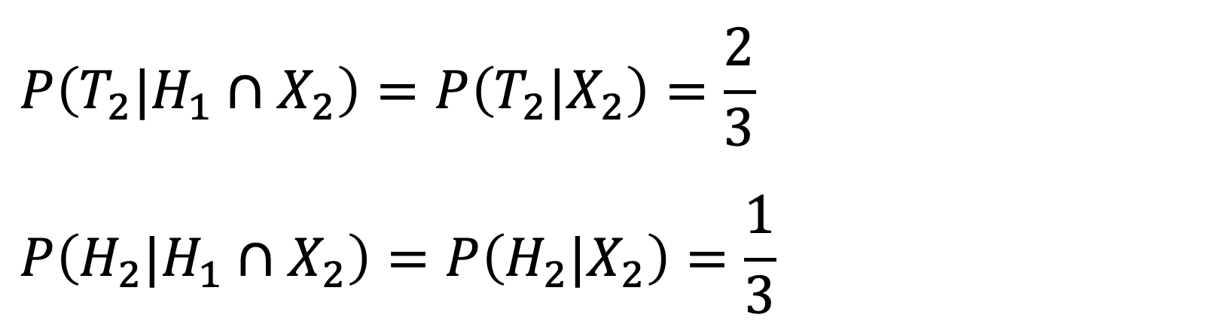
$$P\left(T_{2}|H_{1}∩X_{2}\right)=P\left(T_{2}|X_{2}\right)=\frac{2}{3}$$
$$P\left(H_{2}|H_{1}∩X_{2}\right)=P\left(H_{2}|X_{2}\right)=\frac{1}{3}$$

Slide 23
1
2
3
H

Slide 24
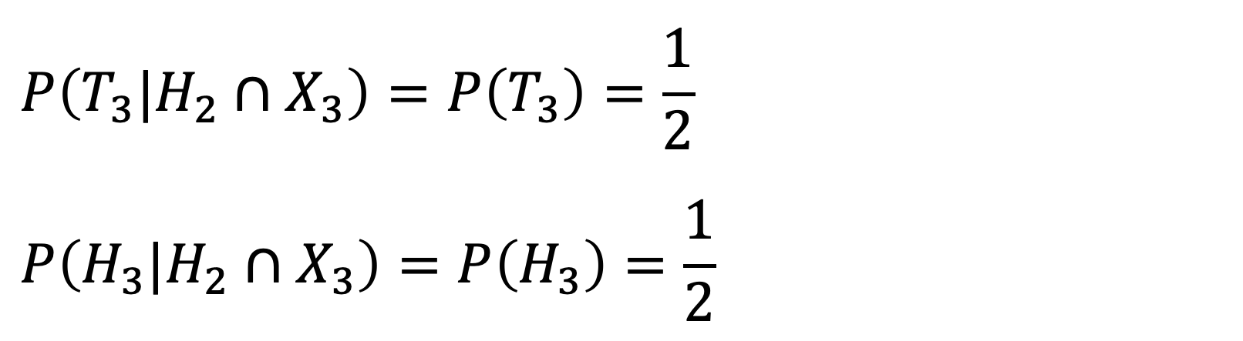
$$P\left(T_{3}|H_{2}∩X_{3}\right)=P\left(T_{3}\right)=\frac{1}{2}$$
$$P\left(H_{3}|H_{2}∩X_{3}\right)=P\left(H_{3}\right)=\frac{1}{2}$$

Slide 25
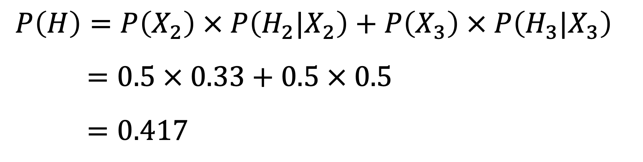
$$P\left(H\right)=P\left(X_{2}\right) × P\left(H_{2}|X_{2}\right)+P\left(X_{3}\right) × P\left(H_{3}|X_{3}\right)$$
$$=0.5 × 0.33+0.5 × 0.5$$
$$=0.417$$

Slide 26
